Slide 1
Added Functionality Using Design Patterns
Christopher Ramirez, Justin Lee, Jene Rene, Precious Iheanacho

Slide 2
Discount Functionality
Preparation:
Update Database to include a discount table with attributes:
discountName: the name of the discount: VARCHAR(30)
discountCode: unique code used at checkout to apply discount to cart: VARCHAR(8)
active: status of the discount: BOOLEAN
fraction: percentage of product price being discounted from product. Value range is (0,1], 1 being the full price of the product for BOGO type discounts. : DOUBLE
Update product table to include an additional attribute `discount`.
Add a foreign key constraint to linking the discount table to the products table through the discount code.
Create classes:
DiscountBean class
DiscountService class
DiscountServiceImpl class
Concrete Discount classes

Slide 3
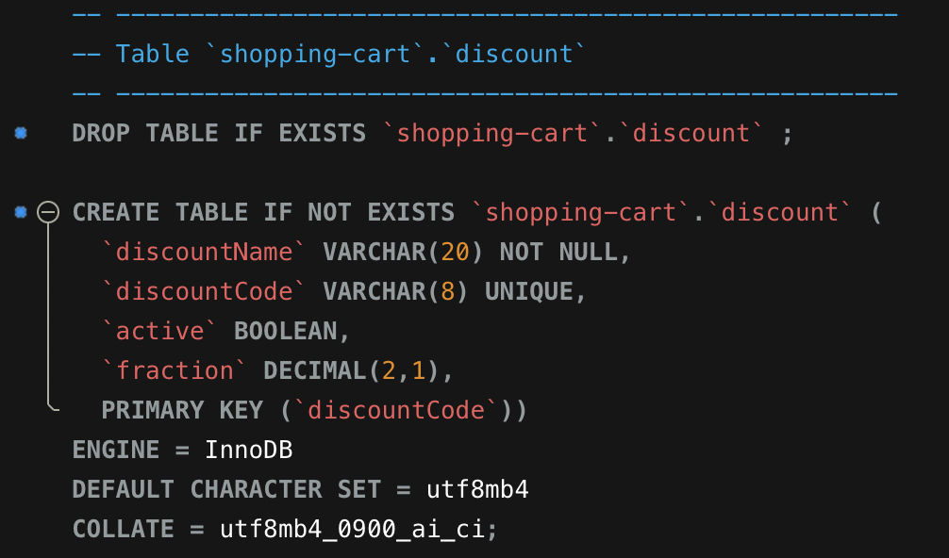
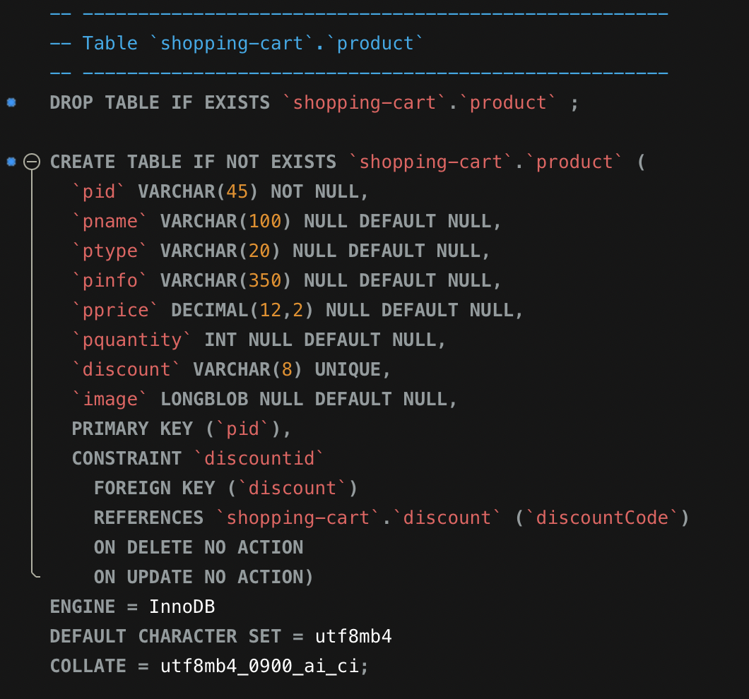
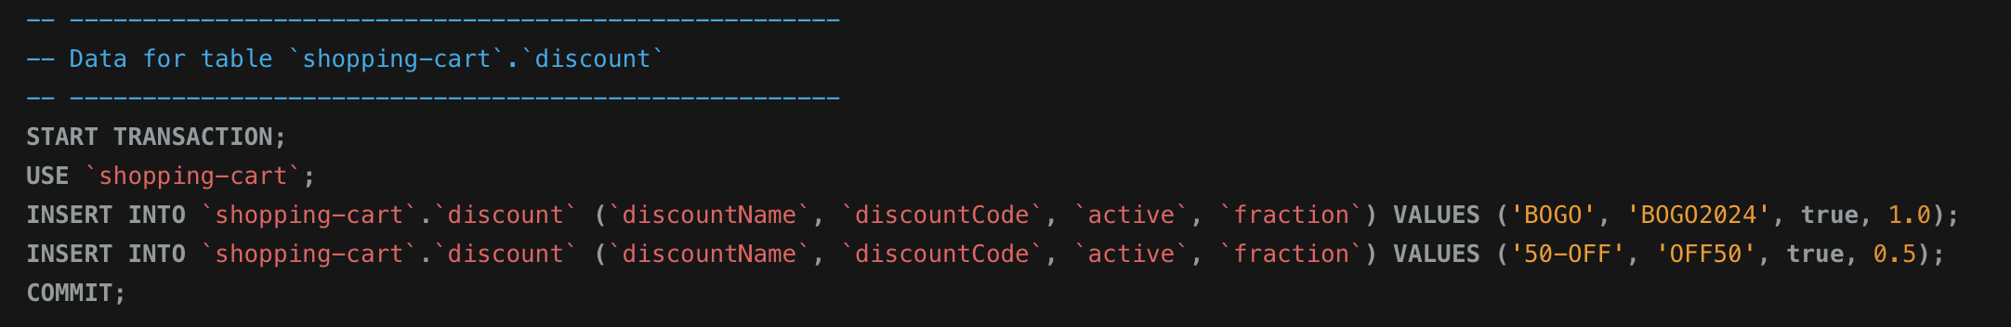
Database Adjustments

Slide 4
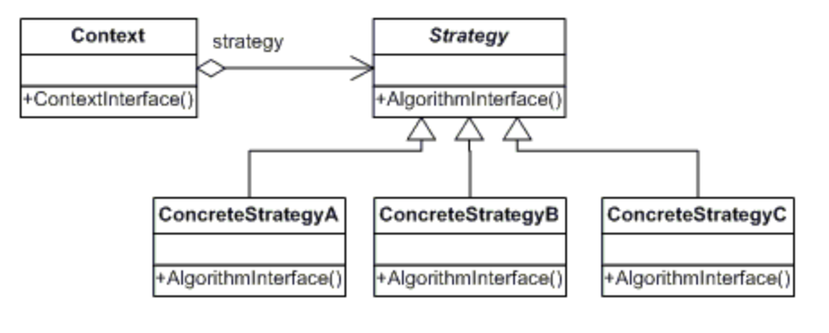
Strategy Pattern
DIscountService
DiscountServiceImp
+applyDiscount()
+applyDiscount()
DIscountBOGO
DiscountPercentage
DiscountShipping
+applyDiscount()
+applyDiscount()
+applyDiscount()

Slide 5
SOLID
Our approach maintains SOLID principles in the following ways:
Single Responsibility Principle – The discount classes have one single responsibility; apply a discount to the cart.
Open/Closed Principle – Our approach is dynamic and expansive. New discounts can be added as concrete classes stemming from the DiscountServiceImp Interface.
Liskov Substitution – each concrete class has a method for applying the appropriate discount to the cart. Therefore, each concrete class can substitute the base class DiscountServiceImp.
Interface Segregation Principle – our DiscountServiceImp Interface has one single responsibility.
Dependency Inversion Principle – classes are depending on abstraction instead of concretion.

Slide 6
Add Product Line Functionality
Update the Database to include a add product line table with attributes:
CREATE TABLE IF NOT EXISTS `shopping-cart`.`product_line` (
`line_id` The line_id serves as a unique identifier for each product line in the product_line table. VARCHAR(45) NOT NULL,
`line_name` line_name provides a clear and descriptive name for each product line, making it easier for users to identify and understand the category or type of products that belong to that line. VARCHAR(100) NOT NULL,
`line_description` line_description offers a more comprehensive explanation of what the product line encompasses. VARCHAR(350) NULL DEFAULT NULL,
Create class:
ProductLineBean
ProductLineService
ProductLineServiceImp

Slide 7
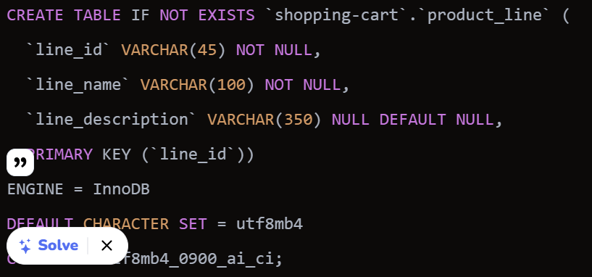
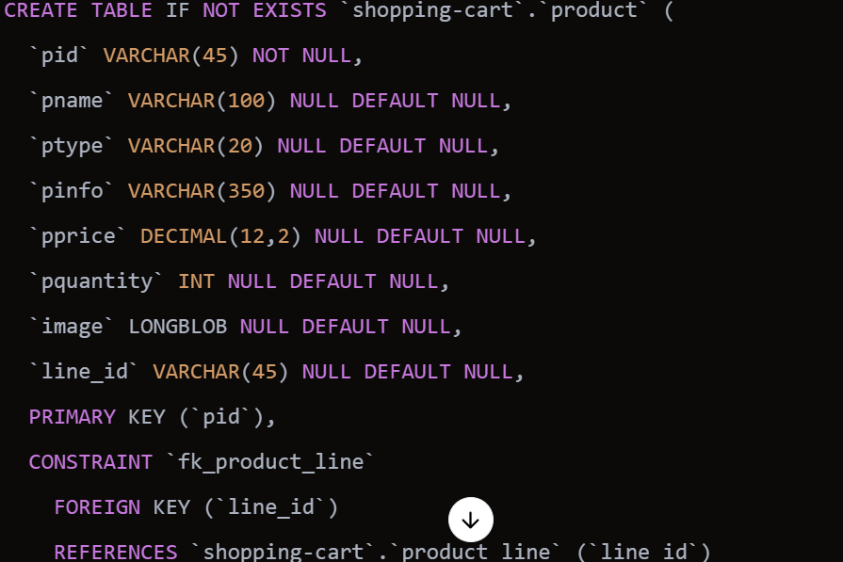
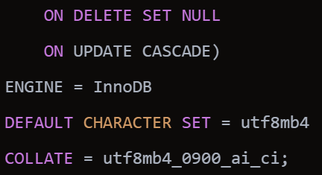
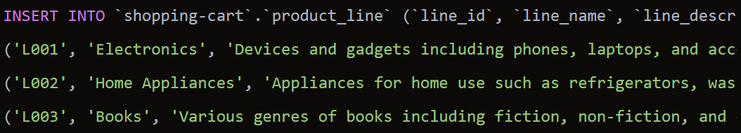
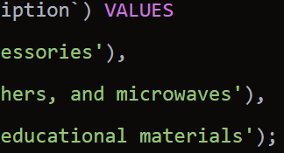
Database Adjustments

Slide 8
Strategy Pattern
ProductLineService
ProductLineServiceImp
+ addProduct()
+ addProduct()
ManualAddProductStrategy
BulkAddProductStrategy
ValidatedAddProductStrategy
+ addProduct()
+ addProduct()
+ addProduct()

Slide 9
SOLID
Single Responsibility Principle (SRP): Each class handles a specific task, such as data representation or a particular product line operation.
Open/Closed Principle (OCP): The system is extendable with new strategies without altering existing code.
Liskov Substitution Principle (LSP): Concrete strategy classes can replace the ProductLineService interface without affecting functionality.
Interface Segregation Principle (ISP): The ProductLineService interface is focused, requiring only relevant methods for implementation.
Dependency Inversion Principle (DIP): The context relies on the ProductLineService interface, allowing easy swapping of strategies.

